Slide 1
CGB1201 – JAVA PROGRAMMING
Department of Artificial Intelligence and Data Science
Academic Year: 2024 – 2025 (Odd Semester)
Register Number : 2303811724322080
Name : PADMAPRIYA S
Year : II
Semester : III
Section : B
Date : 03.12.2024

Slide 2
Title of the Project
CRIME DETECTION IN
CREDIT CARD FRAUD

Slide 3
Problem Identification
Rising Fraud Rates
Credit card fraud is a growing problem with significant financial implications for both individuals and businesses.
Evolving Fraud Tactics
Fraudsters are constantly developing new methods, making it challenging to detect and prevent fraudulent transactions
Impact on Trust
Fraud can damage the reputation of financial institutions and erode consumer trust in online transactions

Slide 4
Objective
1.Real-Time Fraud Detection
Implement advanced algorithms to swiftly identify and flag suspicious transactions, minimizing the risk of financial loss.
2.Reduced False Positives
Optimize the system to accurately distinguish genuine transactions from fraudulent ones, ensuring a seamless customer experience.
3.Adaptability & Scalability
Design a flexible framework that can adapt to evolving fraud patterns and handle increasing transaction volumes.

Slide 5
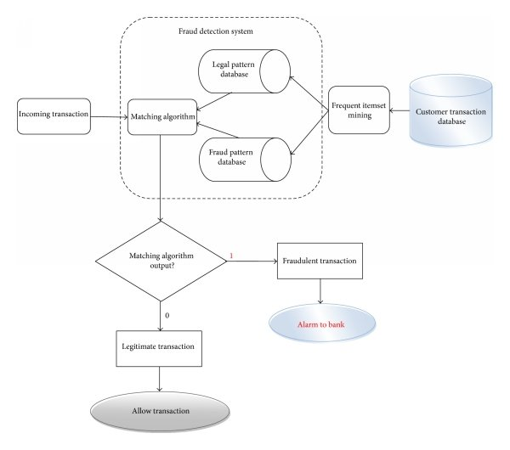
Proposed Architecture

Slide 6
Java Programming - Concepts Used
1. Class and Object-Oriented Programming
2. Encapsulation
3. List Collection Framework
4. Control Flow (Conditional Statements)
5. Methods
6. Static Methods
7. Polymorphism (Method Overriding)
8. Java Standard Library
9. Main Method (Program Entry Point)

Slide 7
List of Modules
Transaction module – Represents transaction details
Fraud detection system module – Contains the core logic for detecting fraud.
Main module – Simulates the transaction flow and integrates the other two modules.

Slide 8
Module Description
Transaction Module
Purpose: Represents individual credit card transactions and their details.
Key Features:
Attributes include:
transactionId - Unique identifier for the transaction.
creditCardNumber - The credit card used for the transaction.
amount - The monetary value of the transaction.
location - Location where the transaction occurred.
timestamp - The time of the transaction.
Methods include:
Getters for accessing transaction details (getTransactionId(), getAmount(), etc.).
toString() for representing the transaction in a human-readable format.

Slide 9
Module Description (Cont..)
Fraud Detection System Module
Purpose: Implements the logic for detecting and flagging suspicious transactions.
Key Features:
Flagged Transactions List: Maintains a list of suspicious transactions (flaggedTransactions).
Rules for Fraud Detection:
Rule 1: Flags transactions exceeding a threshold amount (> $5000).
Rule 2: Flags transactions from high-risk locations (e.g., "High-Risk Country").
Additional rules can be added as needed.
Methods:
isSuspicious(Transaction transaction) - Evaluates whether a transaction is suspicious.
processTransaction(Transaction transaction) - Processes a transaction and flags it if it is suspicious.
getFlaggedTransactions() - Retrieves the list of flagged transactions.

Slide 10
Module Description (Cont..)
Main Module
Purpose: Acts as the entry point of the program and simulates the fraud detection process.
Key Features:
Creates an instance of FraudDetectionSystem.
Simulates sample transactions by creating Transaction objects.
Processes transactions using the FraudDetectionSystem.
Outputs approved transactions and flagged suspicious transactions.
Java Standard Library Modules Used
java.util.ArrayList and java.util.List:
Used to store and manage the list of flagged transactions dynamically.
java.lang.String:
Used for string manipulation (e.g., comparing transaction locations).
System.out.println:
Used for console output, displaying transaction statuses and flagged alerts.

Slide 11
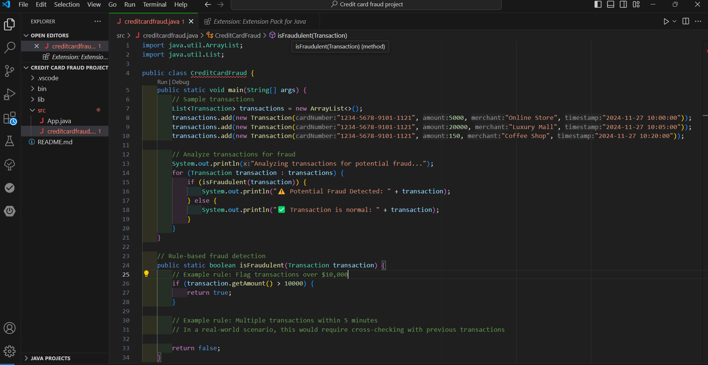
Source Code

Slide 12
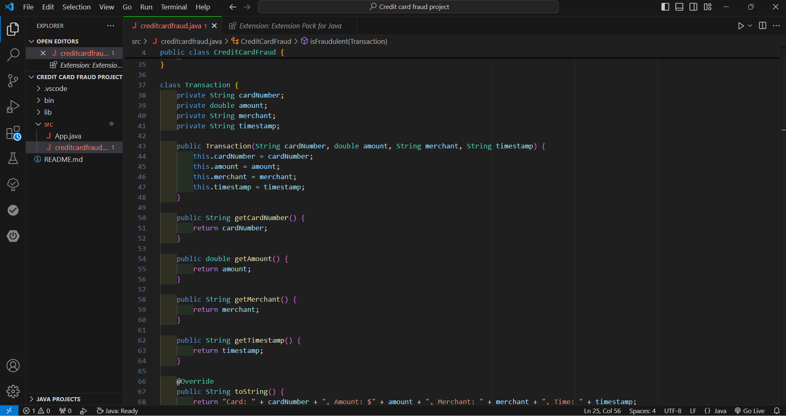
Source Code

Slide 13
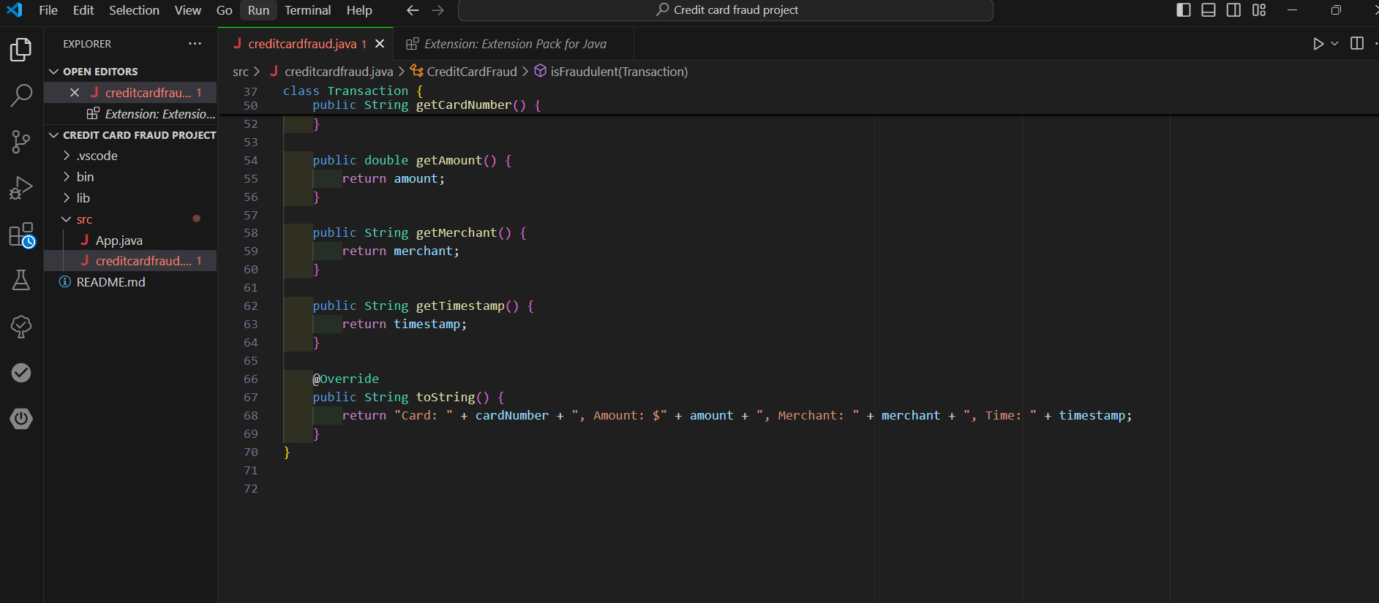
Source Code

Slide 14
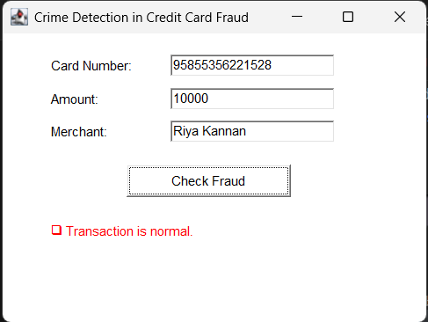
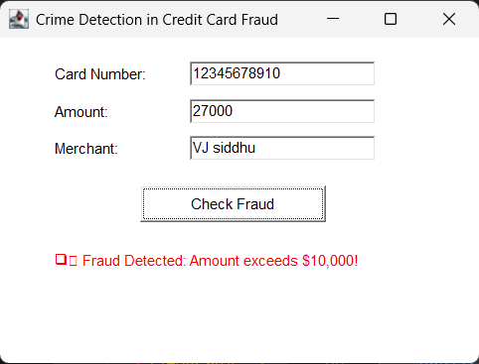
Results

Slide 15
Conclusion
In conclusion, the developed fraud detection system provides an effective solution for identifying and preventing fraudulent credit card transactions by applying predefined rules and logic to assess transaction risk. The system ensures minimal disruption to legitimate transactions while accurately flagging suspicious activities for further investigation. Although the current approach is rule-based, incorporating advanced machine learning techniques and real-time transaction processing could further improve detection accuracy and scalability. Overall, this system lays the foundation for a robust, reliable tool in combating credit card fraud, with potential for further optimization and integration into larger financial networks.

Slide 16
Thank You
ANY QUERIES???

